Slide 1
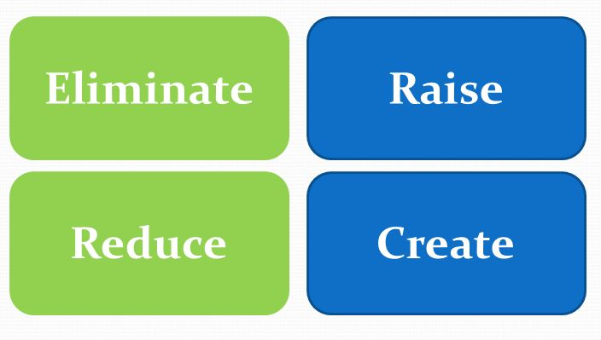

MSC3182
SOCIAL ENTREPRENEURSHIP
Lesson 5
FOUR ACTION FRAMEWORK

Slide 2
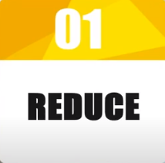
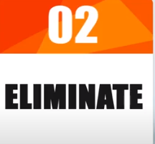
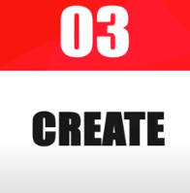
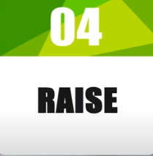
FOUR ACTION FRAMEWORK
With the help of the Four Actions Framework, you need to plot your strategy to see how you are going to be different from the competition.
The four actions-
Benefits that can be reduced well below industry standards.
Benefits that the industry takes for granted and can be eliminated.
Benefits that can be created but the industry has never offered before.
Benefits that can be raised well above the industry standards.

Slide 3


EXAMPLE
French name – Circles of the Sun
Canadian Circus company who made a winning proposition for itself
Circus company started declining – reason
star performers had lot of power over the company and
other forms of entertainment like sports and home entertainment are relatively less than the circus
Lot of pressure from the animal rights group

Slide 4





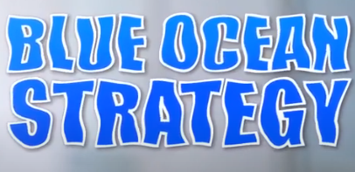

To appeal to a classy adult audience that had abandoned the traditional circus

Slide 5
They plotted the strategy canvas by applying the FOUR ACTION FRAMEWORK

Slide 6
Competitor analysis
Ringling Bros
Barnum & Bailey
Smaller regional circuses

Slide 7

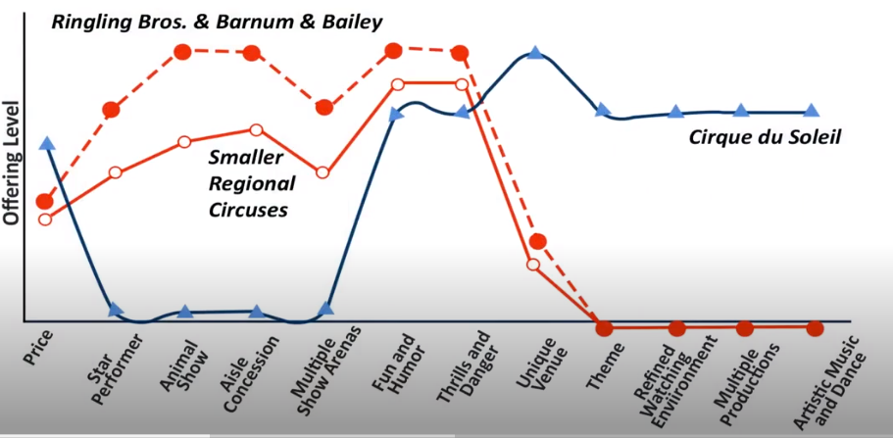


Perceived performance

Slide 8
Eliminated
Reduce
Created/Raised

Slide 9

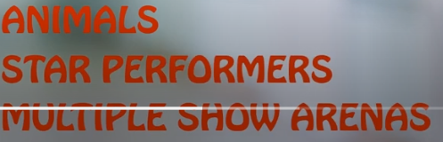


Slide 10



Slide 11

Appeal to whole new group of customers – the
adults,
corporate clients
ready to pay several time more than that been paid for traditional circus

Slide 12


First production was titled

Slide 13

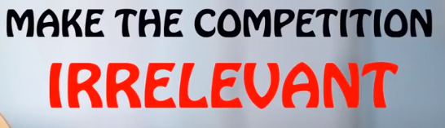
Less than 20 years achieved a revenue their competitors can achieve in another 100 years
Goal is not to beat the competition
Core of the BLUE OCEAN STRATEGY

Slide 14




